Slide 1
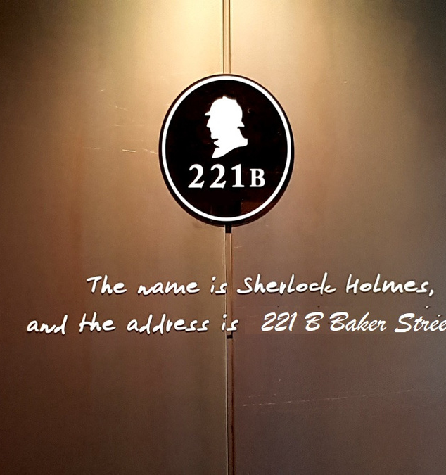

Concurrency in JAVA
Concurrency In JAVA
01
MAKE
MIND MATRIX
... A LEARNING
C F E
BUILDING DREAMS SINCE 1995

Slide 2

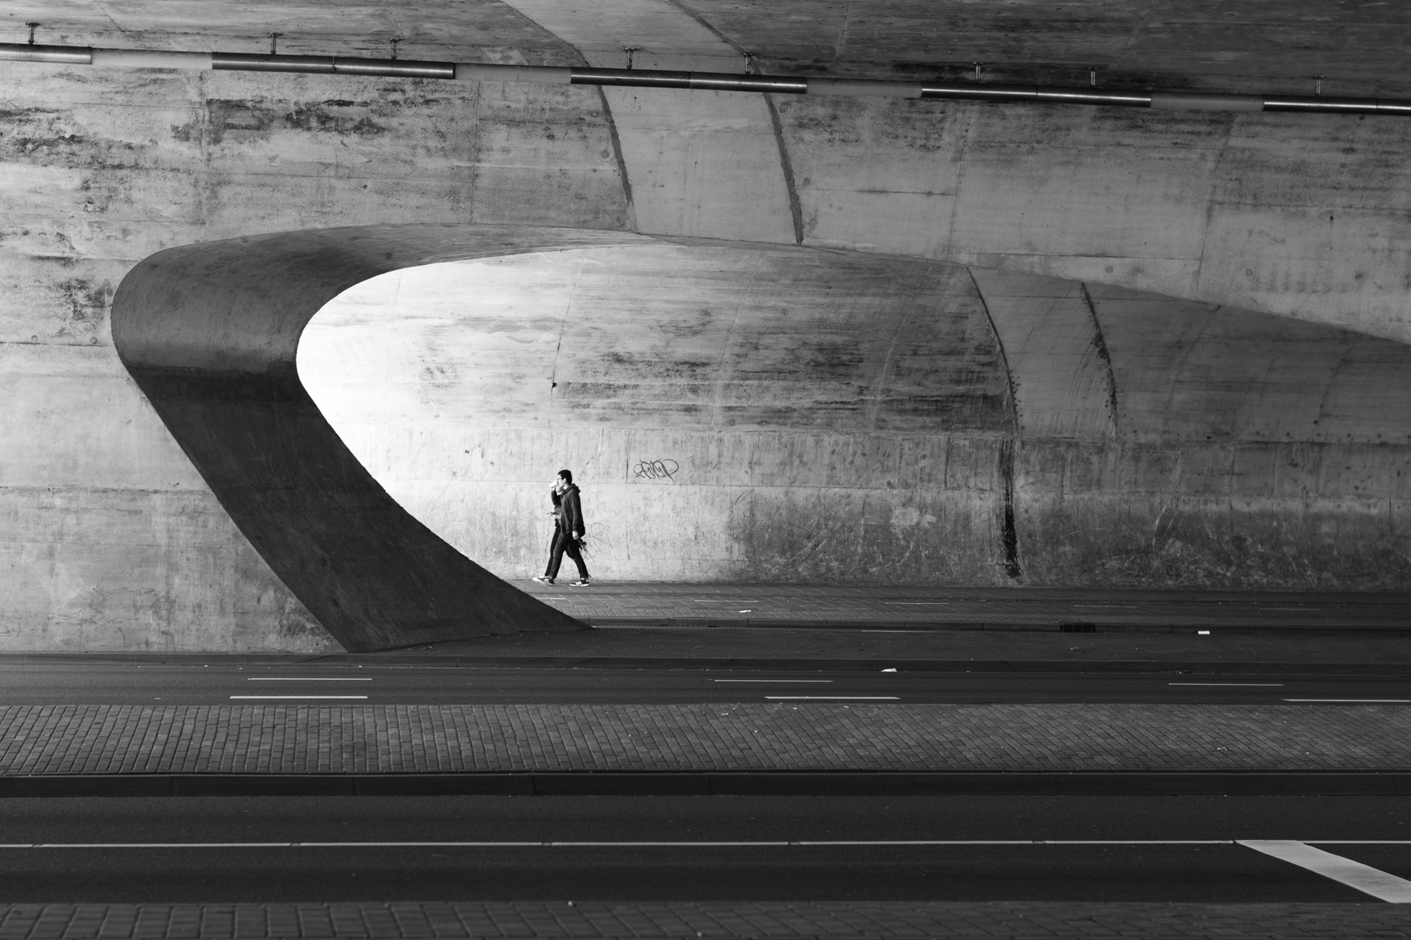


Visual Arts
Eastside Learning Academy
TEACHER:
PAUL SMITH
VISUAL ART
2020
EASTSIDE LEARNING ACADEMY

